Slide 1

Concrete Examples: Ethics on the Job

Slide 2
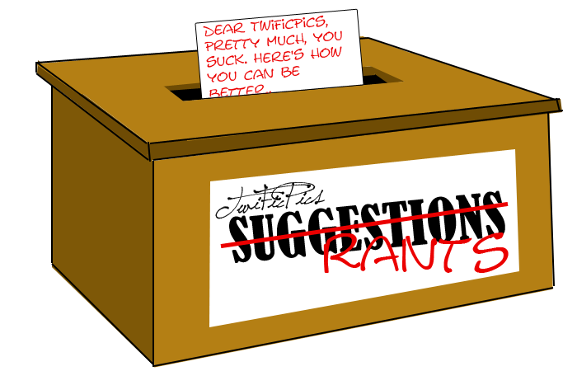
Professional Ethics
Your first job after graduation is system administrator for a 200 person
privately held manufacturing company.
The president/owner sends this message to the employees:
“I want to encourage each of you to make comments to me about any facet of our operation you care to. Your response should be made through our anonymizer program so that your identity will not be disclosed”
The president/owner finds one response saying:
“This company sucks. The only way I find to retaliate for the way I have been treated is sabotage. Every tenth part I turn out is defective.”
The president/owner insists that you examine the computer usage records to determine the identity of the alleged saboteur.
What should you do?
Notes:
http://yourforum.gr/InvisionBoard/index.php?showtopic=392745

Slide 3

Professional Ethics
What factors do you consider?
Pause here and try to write down 4 or 5 things that might influence your decision. Go on to the next slide after you’ve done that.
Notes:
https://blogs.gonzaga.edu/guswtech/the-suggestion-box/

Slide 4
Professional Ethics
What should you do?
These are questions I’d ask myself:
1.
2.
3.
…
These are factors I’d consider:
1.
2.
3.
…
Notes:
http://yourforum.gr/InvisionBoard/index.php?showtopic=392745

Slide 5
Your Job?
Do you want to work for such a boss?
Would a replacement do it?
Your friend?…enemy?
Might the boss find the saboteur without de-anonomizing?

Slide 6
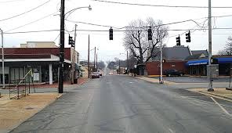
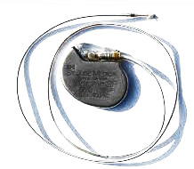


Slide 7
Is there an obvious ethical response?

Slide 8
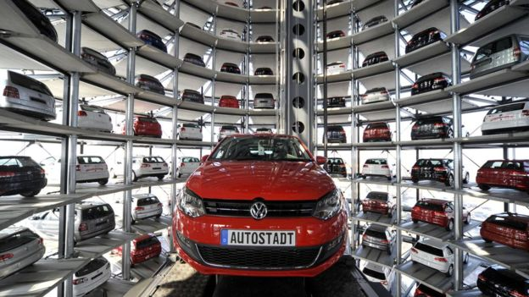
A Real Life Example
“[The device] senses whether the vehicle is being tested or not based on various inputs including the position of the steering wheel, vehicle speed, the duration of the engine’s operation and barometric pressure,” the violation notice reads. “These inputs precisely track the parameters of the federal test procedure” used for EPA certification, it reads.
Algorithms in approximately 482,000 diesel cars sold since 2008.
http://www.scientificamerican.com/article/volkswagen-uses-software-to-fool-epa-pollution-tests/
Notes:
What would you do if your boss asked you to write this code: Algorithm causes car to turn off anti-pollution controls EXCEPT when being inspected. Cheats the government and customers (who were very proud of themselves for buying such a “green” car). Bigger deal in Europe, where diesel is more common.
Image: http://www.bbc.com/news/world-europe-34328689

Slide 9
A Real Life Example
In January 2017, VW pleaded guilty to the emissions scandal and to pay US$4.3 billion in penalties. As of January 2019, 13 VW employees have been indicted, including former CEO Martin Winterkorn, and two former executives (Oliver Schmidt and James Robert Liang) have pleaded guilty in US court and sentenced to prison terms.
Algorithms in approximately 482,000 diesel cars sold since 2008.
http://www.scientificamerican.com/article/volkswagen-uses-software-to-fool-epa-pollution-tests/
Notes:
Liang was an engineer.

